Slide 1
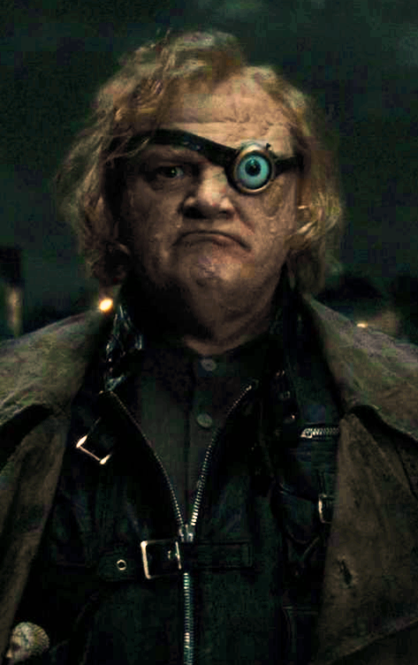
Ethics and the Dark Side
Science, the academic game, and cheating

Slide 2
Ethics beyond copy-pasting
As a student, plagiarism is heavily emphasized in a “Turnitin” sense
But ethics and plagiarism are much broader issues in research
It’s handy to be aware of these issues
Don’t unwittingly do unethical things yourself
Don’t have unethical things done to you
The more people can recognize unethical behaviour, the harder it should be for bad actors to get away with misconduct

Slide 3
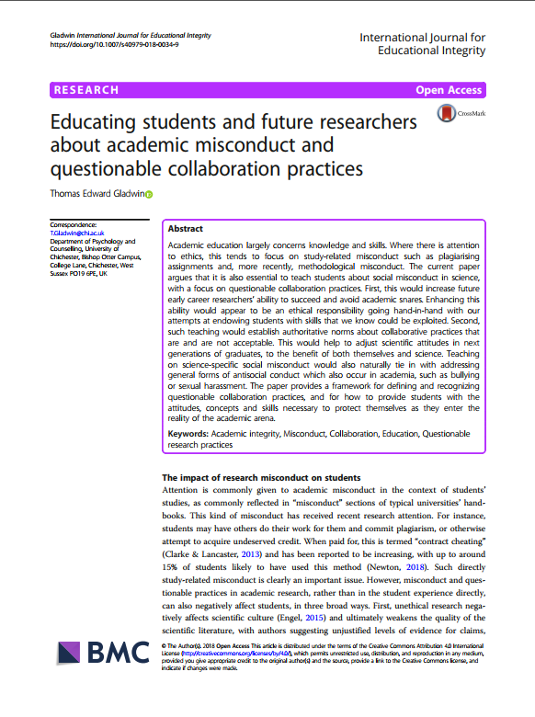
Concepts and source of further references
Educating students and future researchers about academic misconduct and questionable collaboration practices
The aim was to help people to
develop and articulate their own position
recognize questionable behaviour in others
be aware of (implicit) institutional attitudes and policies
And to raise awareness in general

Slide 4
Two types of ethical issues: QRPs and QCPs
Questionable Research Practices, QRPs (John, Loewenstein & Prelec, 2012)
Similar concepts: p-hacking, HARKing, researcher degrees of freedom, voodoo science
This broadly refers to dishonesty involving data
“Torturing your data until it confesses”
Misleading others about results

Slide 5
QRPs
p-hacking in general
There are often very many analysis choices that can influence results
p-hacking: Try them all and pick the one that suits you best!
Selective reporting of (dependent) variables and conditions
Results-dependent stopping of data collection
Lying about an unexpected finding having been predicted (HARKing)
Withholding information that could lead to criticism
Outright fabrication (sometimes distinguished from QRPs)
Hyping: exaggerating the importance or strength of a result

Slide 6
QRPs
“Academic practitioners know that the ultimate aim of science is to establish facts and they therefore must present the nature and scope of their results with the greatest possible precision. Accordingly, they do not prevaricate about their findings or about attendant uncertainties. Scrupulousness also entails the presentation of doubts and contraindications.” Article 1.1 of the Code of Conduct of the University of Groningen.

Slide 7
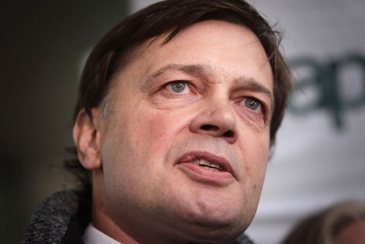
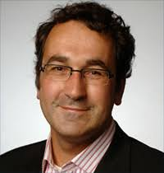
QRPs
The idea of QRPs is now very influential in psychology
The “replication crisis” is considered to be due to widespread QRPs
Misleading researchers, policymakers and the public to further personal ambitions can cause serious harm
Wakefield’s paper in The Lancet caused widespread antivax attitudes
Investment of scarce resources in low-value projects
Use of the wrong medical procedures
Within academia: loss of public confidence in science, institutional reputation loss, rewards going to bad researchers with further knock-on effects
The Stapel affaire

Slide 8
QRPs
Attempts to counter QRPs:
“Open Science” – publicly provide all data, scripts and processes
Minimize costs of honesty
Minimize benefits of dishonesty
Preregistration of analyses
Tip: The Seven Deadly Sins of Psychology, by Dr. Chris Chambers

Slide 9
QCPs
Questionable Collaboration Practices refer to non-methodological, “social” misconduct in science
Scientists often work together and there are “rules” to follow or break
These are less often made explicit than QRPs, but misconduct also causes harm to individuals and damage to science and society
QRPs can be “solved” by just never taking any paper at face value...
Some attention for QCPs in papers and policy statements
Van Loon AJ (1997). Pseudo-authorship. Nature 389(6646):11–11.
Gladwin TE (2018). Educating students and future researchers about academic misconduct and questionable collaboration practices. IJEI, 14:10.

Slide 10
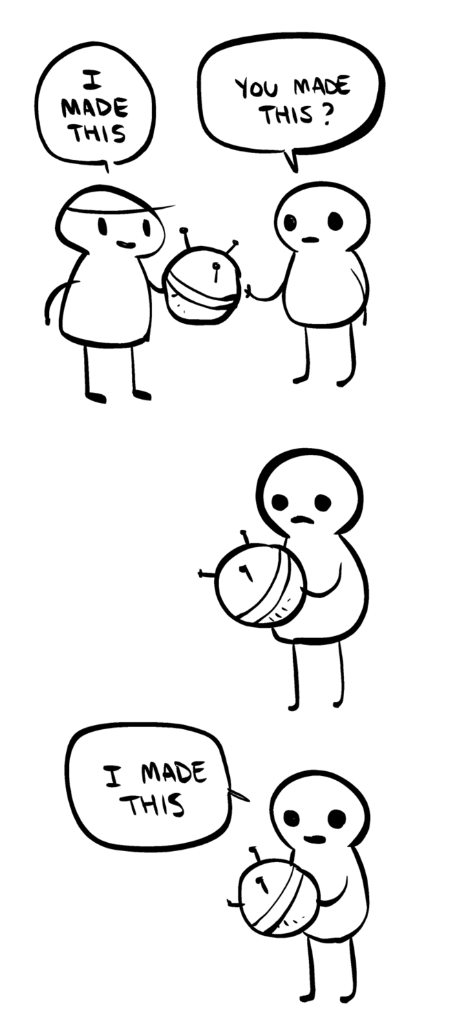
QCPs
QCPs are forms of exploitation and intellectual theft
Questionable authorship practices
Ghost authors (someone should be an author but isn’t)
Guest authors (someone shouldn’t be an author but is)
The tyranny of the incompetent
Coercion: making other people do your work
Stealing credit: plagiarism in the broader sense

Slide 11
QCPs
Exposés of common dirty tricks in QCPs involving students, written by Brian Martin
Martin (2016). Plagiarism, misrepresentation, and exploitation by established professionals: power and tactics
Martin (2013). Countering Supervisor Exploitation

Slide 12
Martin (2013), Countering Supervisor Exploitation
“Some academic supervisors take undue credit for the work of their research students, causing damage to their careers and morale. Students should consider whether to acquiesce, leave, complain or resist. Students should be prepared for supervisor tactics of cover-up, devaluation, reinterpretation, official channels, and intimidation. Options for addressing exploitation include prevention, negotiation, building support, and exposure.”

Slide 13
Martin (2013), Countering Supervisor Exploitation
Fran was a PhD student in a research team. She became highly productive but was distressed that she had to share credit with non-contributors. Her supervisor put his name on every paper, even when she had done 90% of the work, and often her supervisor added one or two other names. In one case she had never heard of her nominal co-author.

Slide 14
Martin (2013), Countering Supervisor Exploitation
Peter, a PhD student, made a discovery, which he eagerly shared with his supervisor. Six months later, his excitement turned to dismay and disgust when he spotted a recent article. His supervisor had published the results without even mentioning Peter's role.

Slide 15
Martin (2013), Countering Supervisor Exploitation
Selena was preparing a postdoc application and obtained some useful feedback from her supervisor. She was startled, however, when he told her that he had put in a grant application in exactly the same area, with the same plan and hypotheses, in collaboration with a colleague. He had never before done research in this area.

Slide 16
Martin (2013), Countering Supervisor Exploitation
“These are examples of exploitation by academic supervisors. The supervisors took credit for their students' ideas and research work, sometimes sharing the credit further with others in what is called gift authorship or honorary authorship, designed to curry favour with collaborators and patrons.[2] In this sort of exploitation, the ideas and work of students and subordinates are expropriated to serve the supervisor's career and reputation.[...] Exploitation can be so highly entrenched in some academic cultures that it is treated as standard practice. It can be called institutionalised plagiarism.[3]”

Slide 17
Martin (2013), Countering Supervisor Exploitation
Although you also have to keep the other side of the story in mind
Students might forget/”forget” how much guidance they got
Students could also steal ideas or findings

Slide 18
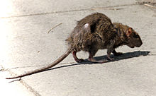
QCPs
QCPs create the false appearance of merit
This is a risk especially when metrics are used blindly
E.g., “Look at all my publications!” – Think: what did you actually do?
Beware research rats and sharks
Rats will use you – the collaborator you don’t really need
Sharks will eat you – the “boss” who knows how to squeeze you
Take care especially in “sandpit” style events
Be very critical: your time is valuable and you don’t owe it to anyone

Slide 19
Conclusion and what to do?
So: be aware of QRPs and QCPs as harmful forms of gamesmanship or cheating that fake actually doing science
Think about what your view is: maybe you think they’re great and you would like to commit them as much as possible!
What if you’re exposed to them?
As a PhD student, it’s often about: pressure to use QRPs; being blamed to cover up supervisor incompetence; or being exploited to do involuntary/uncredited work
→ Research Office
Build up informal knowledge ASAP
Don’t get cynical: vote with your feet
Carefully choose collaborators, groups, institutes

