Slide 1
Seligman’s PhD student
Or: how to break your uppity minion

Slide 2
How could it ever go wrong?
PhD students are among the best and brightest!
Highly motivated!
Intrinsic love of science!
Extrinsic – essential start of career!
Independent workers!
They get years to spend on interesting research!
They get support from experts in their fields!
And yet...

Slide 3
How could it ever go wrong?
It doesn’t seem that idyllic.
Dropout levels around 30% (Stubb et al., 2012; THE, 2013).
Rising attention to serious problems experienced by PhD students. E.g.,
Evans et al. (2018). Evidence for a mental health crisis in graduate education. Nature Biotechnology 36(3), 282–284.
Guthrie et al. (2017). Understanding mental health in the research environment. Rand Corporation.
Levecque K, et al. (2017). Work organization and mental health problems in PhD students. Res Policy 46(4):868–879.
Hargreaves, C. E. et al. (2014). ‘Re-evaluating doctoral researchers’ well-being: what has changed in five years?’ Imperial College London.

Slide 4
Guthrie et al. (2017)
“Fifty-one per cent of the PhD students reported least two symptoms on the GHQ-12 (GHQ2+; indicative of psychological distress), 40 per cent reported at least three symptoms (GHQ3+), and 32 per cent experienced four or more (GHQ4+) and were considered to be ‘at risk of having or developing a common psychiatric disorder’. (Levecque et al., 2017)”

Slide 5
Guthrie et al. (2017)
“The main factors associated with development of depression and other common mental health problems in PhD students are high levels of work demands and work-life conflict, low job control, poor support from the supervisor and exclusion from decision making.
Believing that PhD work is valuable for one’s future career helps reduce stress, as does confidence in one’s own research abilities.”

Slide 6
Guthrie et al. (2017)
“[...]Hargreaves et al. (2014) found that among PhD students, important stressors were a lack of confidence in one’s ability to conduct research to the necessary standard and the feeling of being disappointed in one’s abilities.”
“A 2014 survey of PhD students in the UK found that the second most bothersome issue for them was frustration about research results and a lack of progress (Hargreaves et al. 2014).”
Possible roles of supervisor in this factor?
E.g., unrealistic expectations

Slide 7
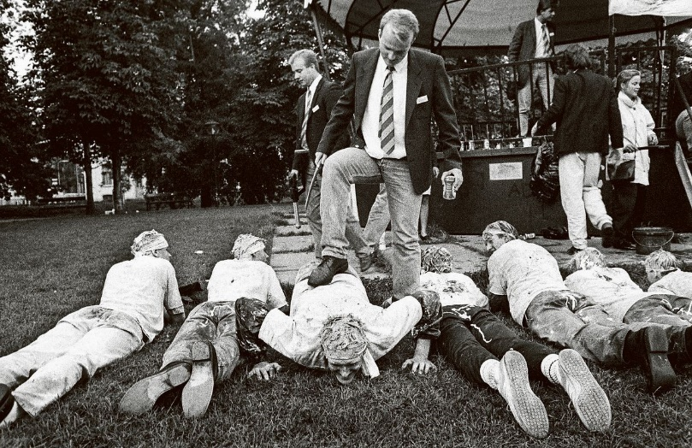
Guthrie et al. (2017)
Among PhD students in a Belgian study, work-life conflict was identified as the most important predictor of mental health problems, followed by work demands (Levecque et al. 2017). This factor was also identified as important in a UK study of PhD students, which found that ‘having a high workload that impacts on your private life’ was a bothersome issue for respondents (Hargreaves et al. 2014).
“Expected” for a PhD student?

Slide 8
What role could supervisors play?
So we have problems we know are concerning:
High work demands and work-life conflict
Low job control and exclusion from decision making
Lack of confidence in one’s own research abilities
Poor support from the supervisor
Lack of belief in value of PhD for one’s future career
In which of these could any responsibility possibly lie with supervisors and by extension the environment and institute?
Some possibly helpful concepts: basic work psych models, learned helplessness, role confusion, exploitation

Slide 9
Models used in work psychology
Very clear links between PhD risk factors and general models of stress and burnout
Ajzen’s Theory of Planned Behaviour
Attitudes: Does the behaviour have value to me?
Subjective norms: Do other (relevant) people think I should do it?
Perceived behavioural control: Can I do it?
Karasek’s Demand-Control model of work stress
Burnout theory: “a state of exhaustion in which one is cynical about the value of one's occupation and doubtful of one's capacity to perform” (Maslach, Jackson, & Leiter, 1996)​

Slide 10
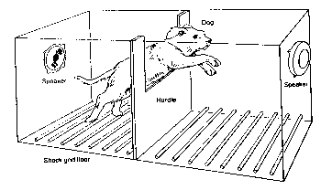
Learned helplessness
Seligman gave dogs either escapable or inescapable shocks
After being exposed to inescapable shocks, dogs gave up, failing to learn to escape even after this was made possible
“Learned helplessness”
Role in abusive relationships, education, and depression

Slide 11
Learned helplessness
Relevant for PhD students?
“Low job control and exclusion from decision making”
“Lack of confidence in one’s own research abilities”
How could PhD students develop “academic learned helplessness”?
Radical changes in plans imposed by supervisor
Bad feedback
Could damage self-confidence unnecessarily
Could be incorrect or contradictory → confusing until cynicism achieved
Lack of competence or expertise in the supervisor
Insufficient support and safety net
Blaming the student
Inadequate resources for the project

Slide 12
Role confusion and supervision modes
Are PhD students...
minions serving as research assistants to the greater glory of their supervisor?
Could this be involved in crossing the line into unhealthy workload?
students completing the last part of their university studies?
independent researchers, or working towards that?
Is “supervision” then...
directive?
supportive?
collaborative?
Ideal mix and time course?

Slide 13
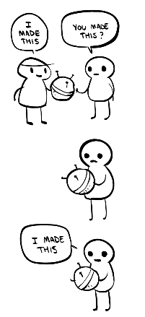
Exploitation
PhD students may suffer from exploitative practices
Inappropriate (or perceived inappropriate) use of the student’s work
Power differential may make it difficult for students to protest
Learned helplessness strikes again?
Papers providing conceptual framework by Brian Martin
Martin (2016). Plagiarism, misrepresentation, and exploitation by established professionals: power and tactics
Martin (2013). Countering Supervisor Exploitation

Slide 14
Martin (2013), Countering Supervisor Exploitation
“Some academic supervisors take undue credit for the work of their research students, causing damage to their careers and morale. Students should consider whether to acquiesce, leave, complain or resist. Students should be prepared for supervisor tactics of cover-up, devaluation, reinterpretation, official channels, and intimidation. Options for addressing exploitation include prevention, negotiation, building support, and exposure.”
“Exploitation can be so highly entrenched in some academic cultures that it is treated as standard practice. It can be called institutionalised plagiarism.[3]”

Slide 15
Exploitation
Beyond the ethical issue, could this tie in to PhD risk factors?
Likely to evoke cynicism - lack of belief in value of academic work
Lack of belief in future career – the benefits are going to someone else
E.g., authorship (diffusion), presentations, grants based on results and ideas, discussions and communication of work
Effect on self-worth – you let it happen
Defensive reactions, e.g., dropout

Slide 16
It’s not necessarily all our fault
Students might forget / “forget” how much guidance they got
There are many factors going into mental health
Despite expectations, students can lack motivation, skills, etc
But this has to raise the critical question – why?

Slide 17
Conclusion
Concern for the wellbeing of students and their research is warranted
Responsibility to PhD students, the institute, and the field
Research suggests a set of known risk factors
Some possibly related processes and attitudes to critically consider
Basic models, learned helplessness, role confusion, exploitation
Directions for research and monitoring?
Qui moderatur supervisoris?

